Slide 1
Classifying Transposable Elements
Alivia Jolley, Phylo Seminar 2024

Slide 2
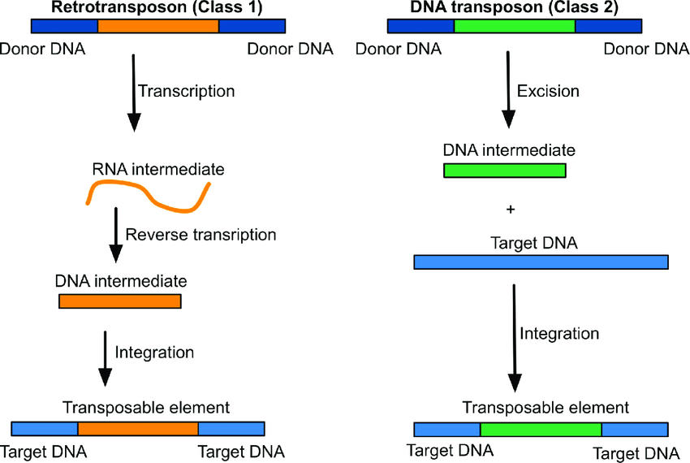
Transposable Elements
Notes:
Mobile genetic elements (MGEs), also known as transposable elements (TEs), are DNA units capable of moving to different positions within genomic DNA using their own enzymatic machinery. As genomic research expands into areas like personalized, ecological, environmental, conservation, biodiversity, and metagenomics, understanding the components of genetic material becomes increasingly crucial. In eukaryotic genomes, protein-coding genes only make up a small percentage, with the majority consisting of poorly understood material labeled "dark matter" or "junk DNA." This material largely comprises TEs and their degraded remnants, or represents products of TE activity during critical evolutionary periods.

Slide 3
Challenges in TE Classification
Different Origins
Varied Structures
Change Rapidly over time
Movement between Species
Extra genes
Incomplete Knowledge
Notes:
Identification and classification of TEs can be challenging due to their high diversity and complex evolutionary histories.
TEs can vary in size, structure, and mechanism of transposition, making it difficult to develop a unified classification system.
The presence of different types of TEs within a single genome further complicates their classification.
Resolving the evolutionary relationships between different TE groups can be challenging, as single-gene phylogenies may not provide sufficient resolution.
The lack of standardized approaches and tools for TE identification and classification across species makes it difficult to compare and analyze TE data from different genomes.
The rapid evolution and horizontal transfer of TEs can blur their phylogenetic signals, making it challenging to accurately classify them.
The vast amount of genomic data and the constant discovery of new TE types require continuous updates and improvements in classification methods.
Overall, the challenges in TE classification arise from their diversity, complex evolutionary histories, and the need for standardized approaches to handle the vast amount of genomic data.

Slide 4
Current TE Classification Systems
Wicker
Repbase
Notes:
Both the Wicker and Repbase classification systems play crucial roles in advancing our understanding of TEs by providing systematic frameworks for their classification and analysis.

Slide 5
Wicker Classification Systems
Classifies TEs based on structural and mechanistic characteristics.
Employs a hierarchical approach, grouping TEs into classes, orders, superfamilies, and families based on shared features such as sequence similarity, mechanism of transposition, and structural organization.
Each TE family is assigned a unique three-letter code for identification within the classification system.
Provides a structured framework for understanding the diversity and evolutionary relationships of TEs within genomes.
Notes:
Developed by Wicker et al., this system classifies TEs based on structural and mechanistic characteristics.
It employs a hierarchical approach, grouping TEs into classes, orders, superfamilies, and families based on shared features such as sequence similarity, mechanism of transposition, and structural organization.
Each TE family is assigned a unique three-letter code for identification within the classification system.
The Wicker classification system provides a structured framework for understanding the diversity and evolutionary relationships of TEs within genomes.

Slide 6
Repbase Classification Systems
Database of repetitive DNA elements, including TEs, maintained and curated by geneticists.
Organizes TEs based on sequence similarities and evolutionary relationships.
It serves as a repository for consensus sequences of TEs, allowing researchers to compare and classify newly discovered TEs based on their similarity to known elements in the database.
Provides a valuable resource for studying the distribution, diversity, and evolutionary dynamics of TEs across different species
Notes:
Repbase is a database of repetitive DNA elements, including TEs, maintained and curated by geneticists.
The Repbase classification system organizes TEs based on sequence similarities and evolutionary relationships.
It serves as a repository for consensus sequences of TEs, allowing researchers to compare and classify newly discovered TEs based on their similarity to known elements in the database.
Repbase provides a valuable resource for studying the distribution, diversity, and evolutionary dynamics of TEs across different species

Slide 7
Bioinformatic Approaches in TE Discovery
Comparative genomics helps analyze TE content across genomes.
Automated pipelines categorize TEs.
Sequence similarity methods like BLAST and HMMER identify TEs by comparing sequences.
Structural features aid in TE classification.
Phylogenetic analysis shows evolutionary relationships between TE groups.
2-D protein structure data improves alignment and phylogenetic inferences.
Integrating experimental data enhances TE classification accuracy.
Notes:
Bioinformatic approaches are essential for TE identification, classification, and annotation.
Comparative genomics is used to analyze TE content across different genomes.
Automated pipelines are employed for TE cataloging and categorization.
Sequence similarity-based methods like BLAST and HMMER are commonly used to identify and classify TEs by comparing their sequences to known TE databases.
Structural features, such as specific domains or conserved motifs, are utilized for TE classification.
Phylogenetic analysis helps understand the evolutionary relationships between different TE groups.
The use of 2-D protein structure information improves alignment quality and phylogenetic inferences, especially for TE-associated proteins lacking conserved catalytic residues.
Integration of experimental data, including functional studies and expression profiling, enhances the accuracy of TE classification.
Overall, bioinformatic approaches, including sequence similarity analysis, structural analysis, and phylogenetic methods, are crucial for TE classification and understanding their evolutionary relationships.

Slide 8
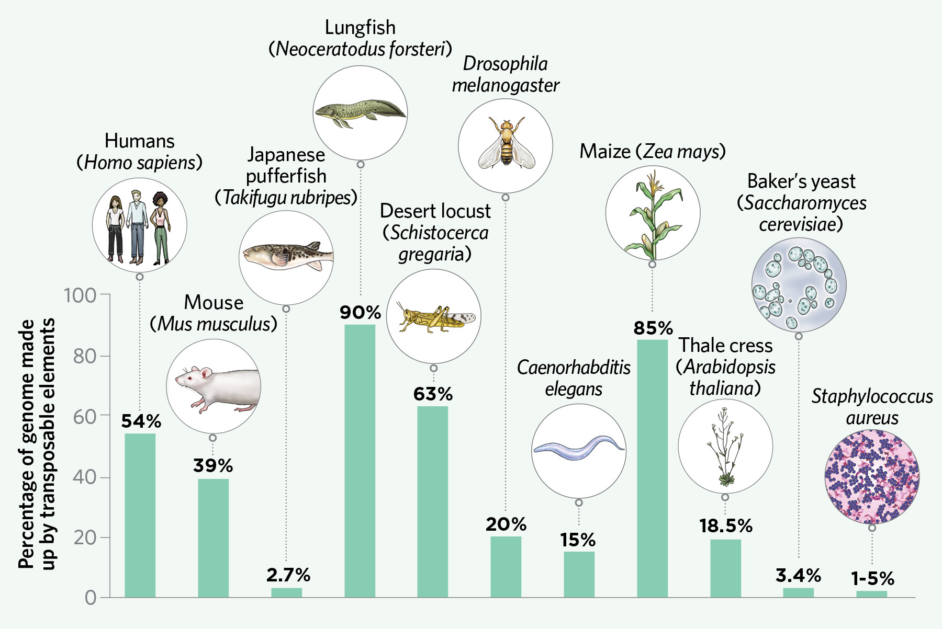
Importance of Reflecting TE Phylogeny
Notes:
TE classification systems should ideally mirror their evolutionary history. However, the polyphyletic nature of TEs presents challenges.
Reflecting TE phylogeny is crucial for understanding evolutionary connections between TE groups and their origins. Phylogenetic analysis identifies common ancestry, evolutionary events like horizontal transfer, and lineage-specific expansions. This method offers insights into TE evolution mechanisms, including new types' emergence and existing ones' divergence. Understanding TE phylogeny aids in developing precise classification systems and annotation tools, predicting TEs' behavior and functional properties based on their evolutionary relationships.

Slide 9
Conventional Phylogenetic Analysis
TEs pose unique challenges for this analysis.
Lack multiple genes like host species
Single TE genes have different evolutionary histories.
Early studies found interesting patterns in TE sequences.
Advances in phylogenetics have expanded TE studies.
Reconstructing RT phylogenies is difficult.
Despite challenges, conventional methods work well within TE families.
Notes:
Phylogenetic methods are key to understanding how Transposable Elements (TEs) have evolved over time. While these methods have been successful in tracing the lineage of organisms, applying them to TEs presents unique challenges.
In host species, multiple co-evolving genes help infer relationships between species. However, TEs lack this advantage. Even a single TE gene can contain multiple domains with different evolutionary histories, making it tricky to construct reliable phylogenetic trees.
Despite these challenges, early TE studies using nucleotide sequences revealed interesting patterns. As phylogenetic methods advanced, so did TE inventories, expanding to include thousands of sequences.
While conventional phylogenetic methods can infer TE evolutionary histories based on aligned sequences, challenges remain. For example, reconstructing RT phylogenies—essential for retroelements—faces difficulties in resolving deep branches, especially when combining genes with different evolutionary rates.
Despite these challenges, conventional phylogenetic analysis works well within TE families and superfamilies, particularly for well-defined clades like eukaryotic non-LTR retrotransposons. Tools like RTclass1 aid in assigning new elements to known clades.

Slide 10
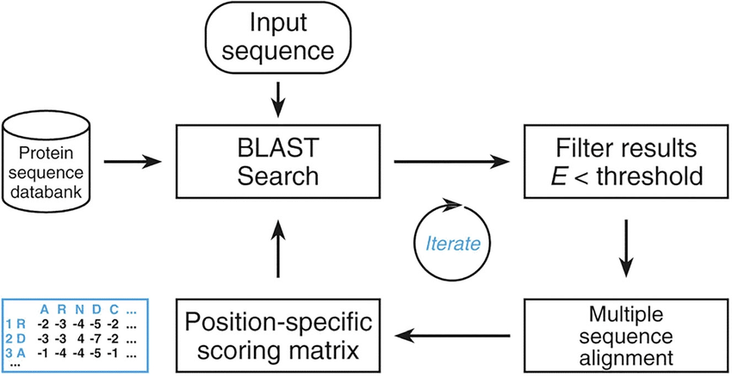
Remote Homologies
Notes:
Now, let's talk about remote homologies and the challenges they bring to TE phylogenetic analysis.
Remote homologies refer to evolutionary relationships between sequences that have diverged significantly over time. When sequences are too distant, building accurate phylogenetic trees becomes challenging. This is particularly true for diverse TE families, where aligning distantly related sequences can be difficult due to their structural complexity and evolutionary divergence.
Considerable challenges arise when attempting to construct traditional phylogenetic trees for diverse TE families. Even with advanced alignment algorithms like ClustalW, MUSCLE, or MAFFT, aligning distantly related TE sequences can be difficult due to their structural complexity and evolutionary divergence.
In such cases, researchers may resort to measuring diversity through pairwise distances rather than constructing phylogenetic trees. This approach calculates the genetic distance between sequences without relying on tree structures.
For example, bacterial reverse transcriptases (RTs) exhibit high sequence diversity, making classification and evolutionary inference difficult. To tackle this, methods like profile-to-sequence comparisons or Position-Specific Iterative Basic Local Alignment Search Tool (PSI-BLAST) scores are used to assess sequence similarity and infer evolutionary relationships.
In essence, studying remote homologies highlights the complexity of TE evolutionary relationships and emphasizes the need for innovative approaches to address the limitations of traditional methods.

Slide 11
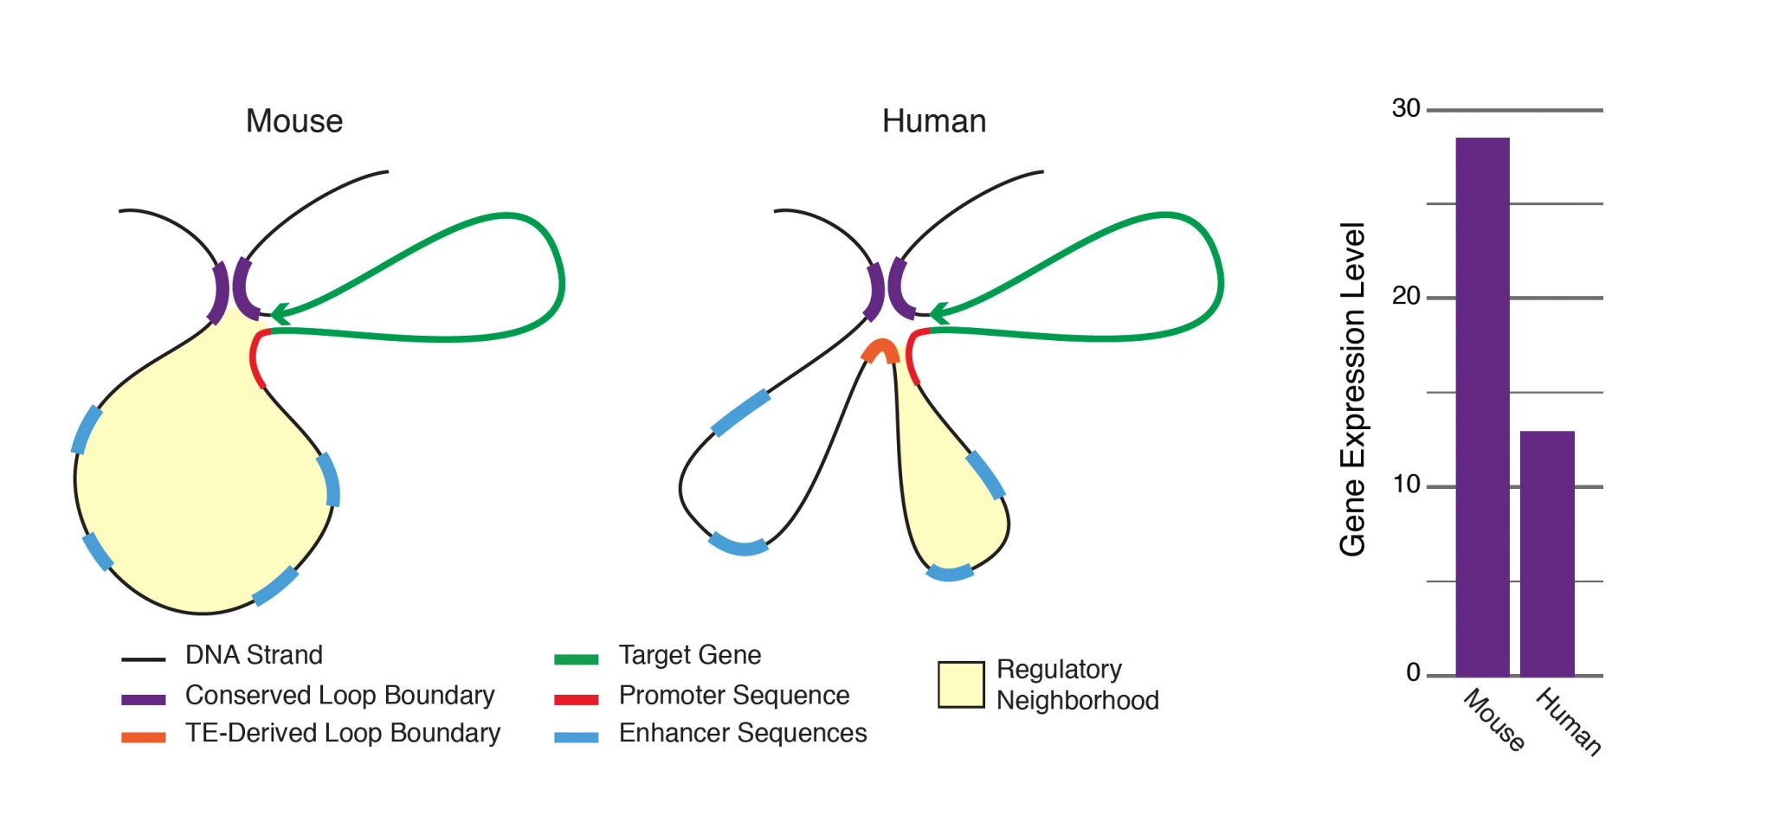
Structure-based alignments and phylogenies
Notes:
Host: Now, let's delve into the role of structure-based alignments and phylogenies in understanding Transposable Element (TE) evolution.
Structure-based alignments leverage our knowledge of the three-dimensional (3D) protein structures of TE-associated proteins to improve alignment quality and phylogenetic inferences. By considering the spatial arrangement of amino acids, structure-based alignments help prevent misalignments by preserving conserved secondary structure elements such as α-helices and β-sheets.
This approach is particularly valuable for TE-associated proteins that lack conserved catalytic residues and are not readily amenable to conventional phylogenetic analysis, such as nucleocapsids. Additionally, analysis of conserved enzymatic components like Transposase (TPases) and Reverse Transcriptases (RTs) can greatly benefit from structure-based alignments.
By aligning sequences based on their structural similarities, researchers can gain additional insights into the evolutionary relationships of TEs. This method allows for a more nuanced understanding of how different TE groups are related to each other and to their presumptive ancestral forms.
Overall, structure-based alignments and phylogenies offer a powerful toolset for studying TE evolution, providing a complementary approach to traditional sequence-based methods. By incorporating structural information, researchers can enhance their understanding of TE evolutionary relationships and uncover new insights into the dynamics of TE evolution over time.

Slide 12
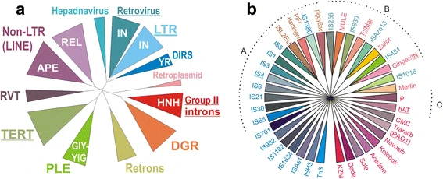
Relationships between DDE transposases
Notes:
Phylogenetic analysis of known RTase types, including those found in TEs, host genes, and non-mobile bacterial RTs.
Representation of 19 DDE TPase eukaryotic superfamilies and 21 prokaryotic DDE families from Repbase and ISfinder databases.
The dendrogram illustrates the relationship between prokaryotic and eukaryotic families, with bacterial families in blue/green and eukaryotic families in orange/red/purple.
Clades A, B, and C are marked, with MuA from phage Mu assigned to clade A.
Some TEs couldn't be assigned to known families due to a lack of representatives.
The summary excludes distantly related DEDD TPases of the RNase H family, as well as other mechanistically different families like HUH, S, Y, or HEN families.

Slide 13
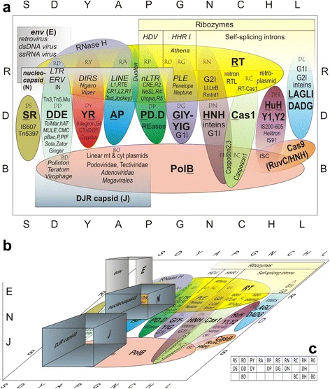
Proposed Classification System
Notes:
The proposed TE classification system suggests categorizing transposable elements (TEs) based on three element-encoded functions crucial for their proliferative capacity: replicative, integrative, and structural. These components, particularly the first two, are enzymatic in nature, while the latter are largely non-enzymatic and exhibit more conservation in structure than in sequence. TEs may also encode other enzymatic or structural functions, but these are less relevant for classification as they are not critical for core mobility functions.
The diversity of TEs, both prokaryotic and eukaryotic, is represented on a two-dimensional grid, with integrative components (nucleases/phosphotransferases) along the columns and polymerizing components (R, B, or D) along the rows. The overlap or lack thereof between these components creates distinct TE categories at each intersection. Structural components, symbolized by square-shaped symbols, may extend into the third dimension, potentially giving rise to virus-like entities and facilitating intra- and intercellular movements.
This classification scheme allows for expansion to accommodate additional types of polymerases, integrases, and structural components, and may help discover previously undescribed combinations in the vast diversity of sequenced life forms.
Diversity of polymerase-phosphotransferase combinations in mobile elements. The main types of polymerases and endonucleases are in boldface, and are also shown in single-letter codes along the two respective axes. Two-letter combinations are shown for each TE type at the intersections.

Slide 14
Proposed Classification System
Notes:
Same, with addition of structural components in the third dimension. c A 2-D grid listing the currently known combinations of polymerases and endonucleases. A few additional types of endonucleases found only in group I introns are not shown for simplicity

Slide 15
Questions/Discussion

